Slide 1
SIGMA360 Salesforce CRM Alpha
Naming Convention & Documents Management Procedure

Slide 2
Naming Convention
S360-SAF-DOCUMENT_NAME-YYQQ-CLASS-V0.00
^{S360: SIGMA360 / Project Name}
SAF: Salesforce / The part of the project SIGMA360 developed on Salesforce
DOCUMENT_NAME: it’s clear, right?
YYQQ: Year + Quarter (1,2,3,4) / Ex: 23Q3
^{CLASS:}
REST=Restricted / TEAM=Can only be shared within the project's team / OPEN=Publicly accessible
V0.00: V1.00=Major Version, deliverable to client / V0.12=Minor Version, Work in Progress

Slide 3
Document Type
(to be edited to match the SAF)
Purchase | PUR | Business Process | BPS
Administration | ADM | Customizing Guide | CUG
Accounting | ACC | User Guide | USG
Financial | FIN | Blueprint | BLU
Warehousing | WM | Detailled specification | DSP
Logistics | LE | Technical specification | TSP
Legal | JUR | Tests report | TSR
Marketing | MKT | Minutes of Meeting | MOM
Manufacturing | MFG | Contract | CTC
Quality | QAL | Business Rules | BR
Inventory | INV | Risk matrix | RIS
Human Ressources | HR
Reglementaire | REG | PGD

Slide 4
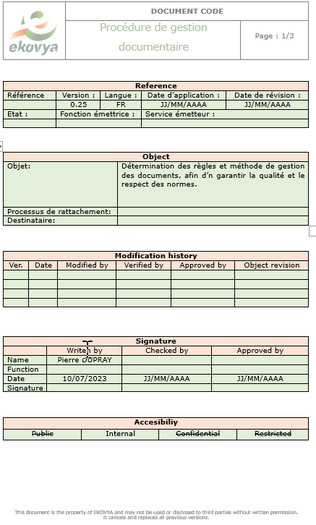
Document management procedure

Slide 5
DOCUMENTS MANAGEMENT PROCEDURE
Document author
updated by
last proofread by
Validated by

